Slide 1
High level Data Link Control- HDLC
High-level Data Link Control (HDLC) is a bit-oriented protocol for communication over point-to-point and multipoint links.
It uses Stop-and-wait protocol.
Configuration and Transfer modes: Two transfer modes that can be used in different configurations.
Normal Response Mode (NRM): The station configuration is unbalanced. We have one primary station and multiple secondary stations.
A primary station can send commands; a secondary station can only respond. The NRM is used for both point-to-point and multipoint links
Asynchronous Balanced mode (ABM): The configuration is balanced. The link is point-to-point, and each station can function as a primary and a secondary (acting as peers).

Slide 2
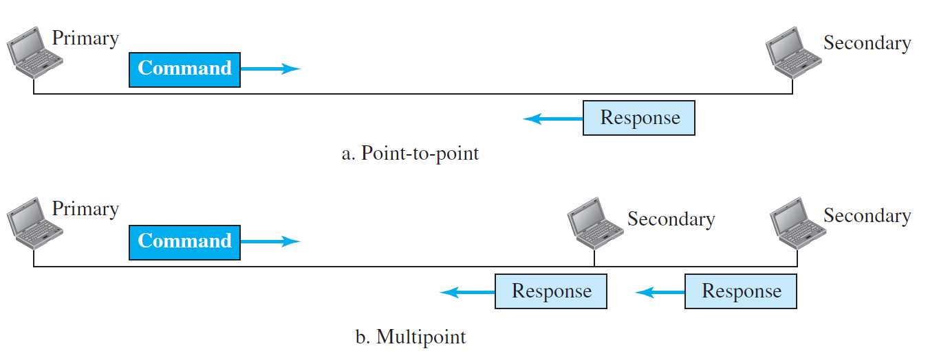
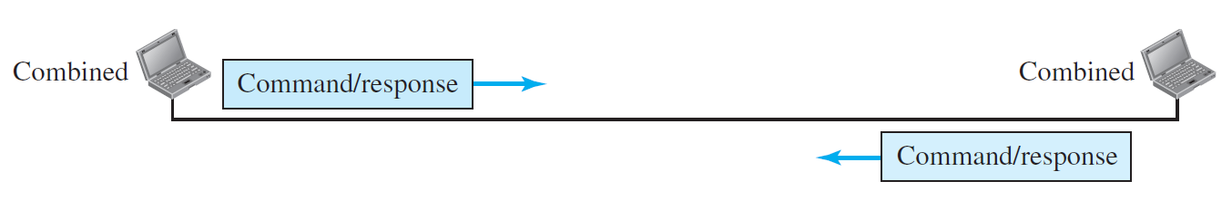
High level Data Link Control- HDLC
Asynchronous Balanced mode (ABM):
Normal Response Mode (NRM):

Slide 3
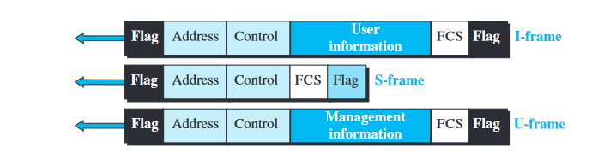
HDLC Frames
Flag field -This field contains synchronization pattern 01111110, which identifies both the beginning and the end of a frame.
Address field -This field contains the address of the secondary station. If a primary station created the frame, it contains a to address. If a secondary station creates the frame, it contains a from address. The address field can be one byte or several bytes long, depending on the needs of the network.
Control field-The control field is one or two bytes used for flow and error control.
Information field -The information field contains the user’s data from the network layer or management information. Its length can vary from one network to another.
FCS field - The frame check sequence (FCS) is the HDLC error detection field. It can contain either a 2- or 4-byte CRC.

Slide 4
How HDLC Work
In HDLC, data is organized into a unit (called a frame) and sent across a network to a destination that verifies its successful arrival.
The HDLC protocol also manages the flow or pacing at which data is sent.
HDLC is one of the most commonly used internet protocols (IP) in what is Layer 2 of the industry communication reference model called Open Systems Interconnection (OSI).
Layer 1 is the detailed physical level that generates and receives the electronic signals.
Layer 3 is the higher level that has knowledge about the network, including access to router tables that indicate where to forward or send data.
On sending, programming in Layer 3 creates a frame that usually contains source and destination network addresses. HDLC (Layer 2) encapsulates the Layer 3 frames, adding data link control information to a new, larger frame.

Slide 5
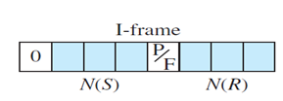
Information- Frames
Control field for I-frames:
I-frames are designed to carry user data from the network layer.
In addition, they can include flow- and error-control information (piggybacking).
If the first bit of the control field is 0, this means the frame is an I-frame.
The next 3 bits, called N(S), define the sequence number of the frame ( 0 to 7).
The last 3 bits, called N(R), correspond to the acknowledgment number when piggybacking is used.
The P/F field has meaning only when it is set (bit = 1) and can mean poll or final.
It means poll when the frame is sent by a primary station to a secondary. (when the address field contains the address of the receiver).
It means final when the frame is sent by a secondary to a primary (when the address field contains the address of the sender).
500

Slide 6

Supervisory Frames
Control field for S-frames:
Supervisory frames are used for flow and error control whenever piggybacking is either impossible or inappropriate.
If the first 2 bits of the control field are 10, this means the frame is an S-frame.
The last 3 bits, called N(R), correspond to the acknowledgment number (ACK) or negative acknowledgment number (NAK), depending on the type of S-frame.
The 2 bits called code are used to define the type of S-frame itself:
Receive Ready (RR): code = 00. This kind of frame acknowledges the receipt of a safe and sound frame or group of frames. N(R) is acknowledgment number.
Receive Not Ready (RNR): code= 10. It acknowledges the receipt of a frame or group of frames, and it announces that the receiver is busy and cannot receive more frames. It acts as a kind of congestion-control mechanism by asking the sender to slow down. N(R) is acknowledgment number.
Reject (REJ): code= 01. It is a NAK that can be used in Go-Back-N ARQ to improve the efficiency of the process by informing the sender, before the sender timer expires, that the last frame is lost or damaged. N(R) is negative acknowledgment number.
Selective Reject (SREJ): code=11. This is a NAK frame used in Selective Repeat ARQ. N(R) is negative acknowledgment number.
500

Slide 7

Unnumbered Frames
Control field for U-frames:
If the first 2 bits of the control field are 11, this means the frame is an U-frame
Unnumbered frames are used to exchange session management and control information between connected devices.
Information field in the frame is the system management information.
U-frame codes are divided into two sections: a 2-bit prefix before the P/F bit and a 3-bit suffix after the P/F bit.
Together, these two segments (5 bits) can be used to create up to 32 different types of U-frames.
500

Slide 8
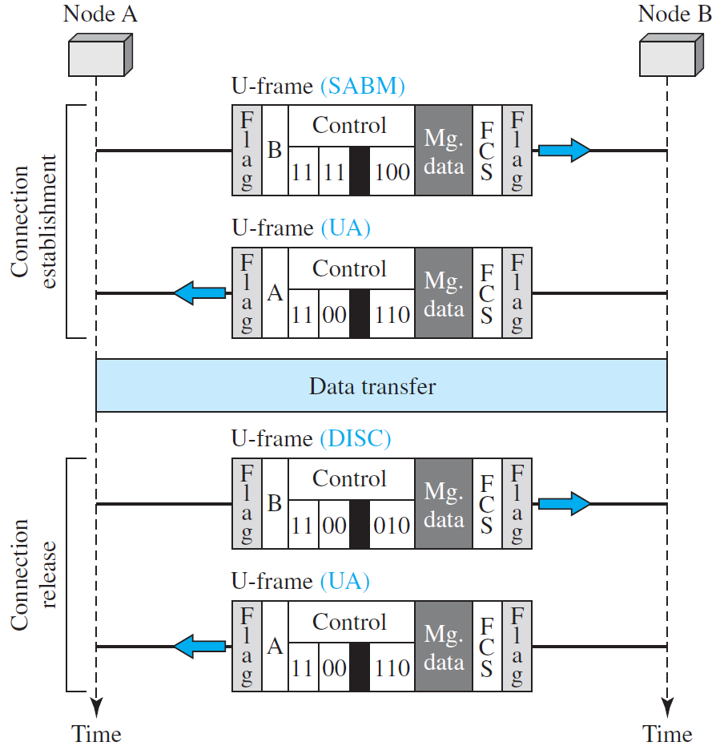
Example of Connection and Disconnection
Node A asks for a connection with a set asynchronous balanced mode (SABM) frame; node B gives a positive response with an unnumbered acknowledgment (UA) frame.
After these two exchanges, data can be transferred between the two nodes.
After data transfer, node A sends a DISC (disconnect) frame to release the connection; it is confirmed by node B responding with a UA (unnumbered acknowledgment).
500

Slide 9
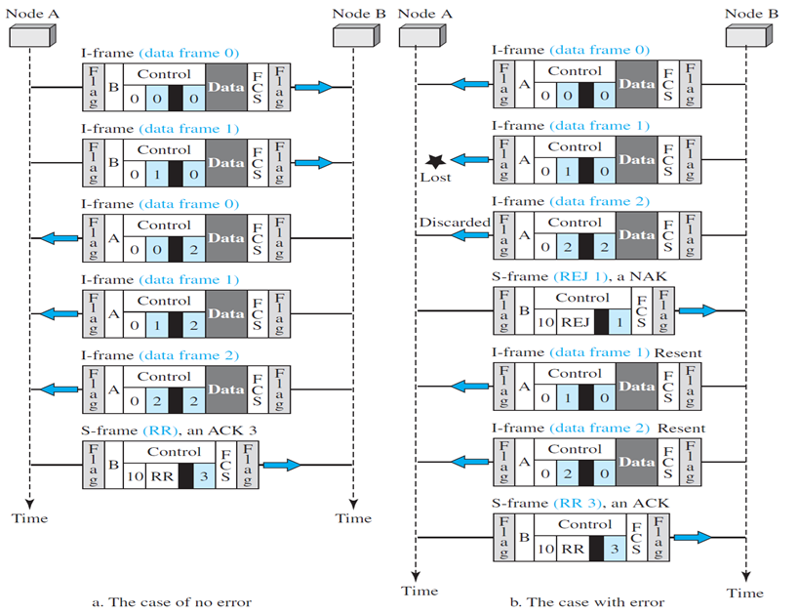

Example of Piggybacking
500
The first is the case where no error has occurred; the second is the case where an error has occurred and some frames are discarded.

Slide 10
Point-to-Point Protocol(PPP)
One of the most common protocols for point-to-point access is the Point-to-Point Protocol (PPP).
Today, millions of Internet users who need to connect their home computers to the server of an Internet service provider use PPP.
The majority of these users have a traditional modem; they are connected to the Internet through a telephone line, which provides the services of the physical layer.
But to control and manage the transfer of data, there is a need for a point-to-point protocol at the data-link layer.
Point-to-Point Protocol is a data link layer communication protocol between two routers directly without any host or any other networking in between.
It can provide loop detection, authentication, transmission encryption, and data compression.

Slide 11
Point-to-Point Protocol(PPP)
Services of PPP:
PPP defines the format of the frame to be exchanged between devices. It also defines how two devices can negotiate the establishment of the link and the exchange of data.
PPP is designed to accept payloads from several network layers (not only IP). Authentication is also provided in the protocol, but it is optional.
The new version of PPP, called Multilink PPP, provides connections over multiple links. One interesting feature of PPP is that it provides network address configuration.
This is particularly useful when a home user needs a temporary network address to connect to the Internet.
Services not provided by PPP:
PPP does not provide flow control. A sender can send several frames one after another with no concern about overwhelming the receiver.
PPP has a very simple mechanism for error control. A CRC field is used to detect errors. If the frame is corrupted, it is silently discarded; the upper-layer protocol needs to take care of the problem.
Lack of error control and sequence numbering may cause a packet to be received out of order.
PPP does not provide a sophisticated addressing mechanism to handle frames in a multipoint configuration.

Slide 12
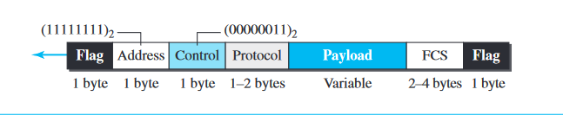
Point-to-Point Protocol(PPP) Frame Format
Flag- A PPP frame starts and ends with a 1-byte flag with the bit pattern 01111110.
Address-The address field in this protocol is a constant value and set to 11111111 (broadcast address).
Control-This field is set to the constant value 00000011 (imitating unnumbered frames in HDLC).
Protocol- The protocol field defines what is being carried in the data field: either user data or other information. This field is by default 2 bytes long, but the two parties can agree to use only 1 byte.
Payload field -This field carries either the user data or other information. The data field is a sequence of bytes with the default of a maximum of 1500 bytes; but this can be changed during negotiation.
The data field is byte-stuffed if the flag byte pattern appears in this field. Because there is no field defining the size of the data field, padding is needed if the size is less than the maximum default value or the maximum negotiated value.
FCS-The frame check sequence (FCS) is simply a 2-byte or 4-byte standard CRC.

Slide 13
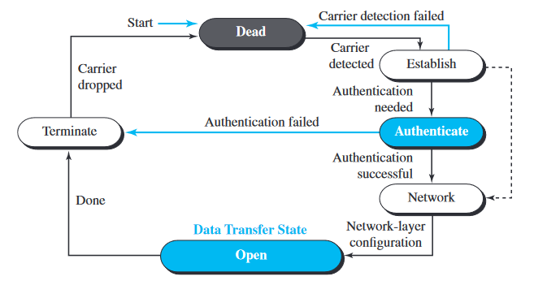
Point-to-Point Protocol(PPP)-Transition Phases

Slide 14
Point-to-Point Protocol(PPP)-Transition Phases
The transition diagram, which is an FSM, starts with the dead state. In this state, there is no active carrier (at the physical layer) and the line is quiet.
When one of the two nodes starts the communication, the connection goes into the establish state. In this state, options are negotiated between the two parties.
If the two parties agree that they need authentication then the system needs to do authentication otherwise, the parties can simply start communication.
The link-control protocol packets, are used for exchanging of data. Data transfer takes place in the open state.
When a connection reaches this state, the exchange of data packets can be started. The connection remains in this state until one of the endpoints wants to terminate the connection.
In this case, the system goes to the terminate state. The system remains in this state until the carrier (physical-layer signal) is dropped, which moves the system to the dead state again.

Slide 15
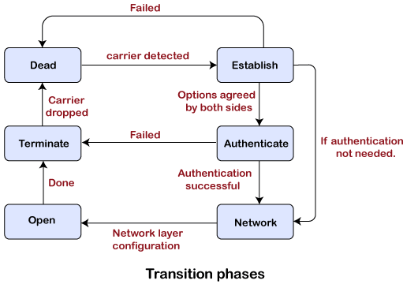
Point-to-Point Protocol(PPP)-Transition Phases
.

Slide 16
Point-to-Point Protocol(PPP)-Transition Phases
Dead: Dead is a transition phase which means that the link is not used or there is no active carrier at the physical layer.
Establish: If one of the nodes starts working then the phase goes to the establish phase. In short, we can say that when the node starts communication or carrier is detected then it moves from the dead to the establish phase.
Authenticate: It is an optional phase which means that the communication can also moves to the authenticate phase. The phase moves from the establish to the authenticate phase only when both the communicating nodes agree to make the communication authenticated.
Network: Once the authentication is successful, the network is established or phase is network. In this phase, the negotiation of network layer protocols take place.
Open: After the establishment of the network phase, it moves to the open phase. Here open phase means that the exchange of data takes place. Or we can say that it reaches to the open phase after the configuration of the network layer.
Terminate: When all the work is done then the connection gets terminated, and it moves to the terminate phase.
.

Slide 17
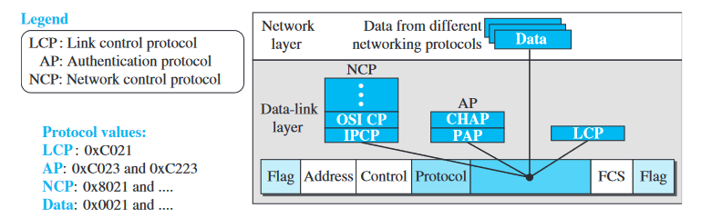
Point-to-Point Protocol(PPP)-Transition Phases
PPP is a link-layer protocol, it uses another set of protocols to establish the link, authenticate the parties involved, and carry the network-layer data.
Three sets of protocols are defined to make PPP powerful: the Link Control Protocol (LCP), two Authentication Protocols (APs), and several Network Control Protocols (NCPs).
At any moment, a PPP packet can carry data from one of these protocols in its data field. Data may also come from several different network layers.

Slide 18
HDLC Vs PPP
Basis of Difference | HDLC | PPP
Definition | Bit-oriented synchronous information interface convention. | Byte-oriented non-concurrent information connects convention.
Standardization | It has been standardized by an international standards organization and is widely recognized and used across the world. | The standardization followed by the protocol is IETF and it is an open standard so can be used by people very easily.
Encapsulation | They can carry data from different network layer protocols within their frames | PPP have the ability to encapsulate different protocols.
Authentication | It does not provide a way to verify the identity of the devices communicating over the network. | These mechanisms allow the devices communicating over the network to verify each other’s identity before establishing a connection.
Application | It is often used for transmitting data between devices within a local network. | PPP is commonly used for dial-up and PPPoE (Point-to-Point Protocol over Ethernet) connections.

Slide 19
PPP Vs HDLC
HDLC is often used in specialized applications that require synchronous data transmission and precise timing, such as in telecommunications and some industrial control systems.
HDLC is a more rigid protocol designed for specific applications, especially those requiring synchronous communication
PPP: is used in a wide range of network scenarios, including dial-up, DSL, broadband, and wireless connections, making it more versatile.
PPP is a versatile and widely adopted protocol suitable for a broader range of network connections offering features like security, flexibility, and lower overhead.

